Slide 1


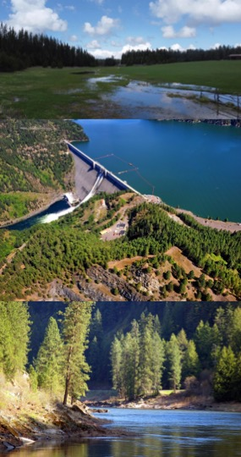
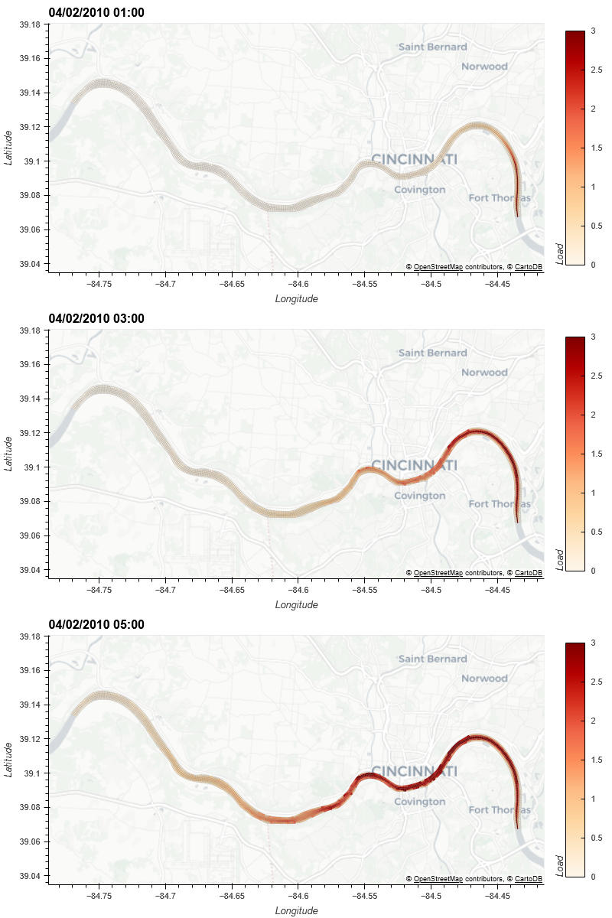
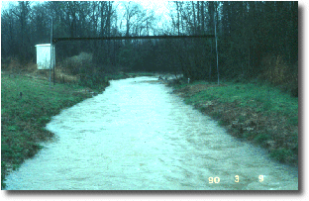
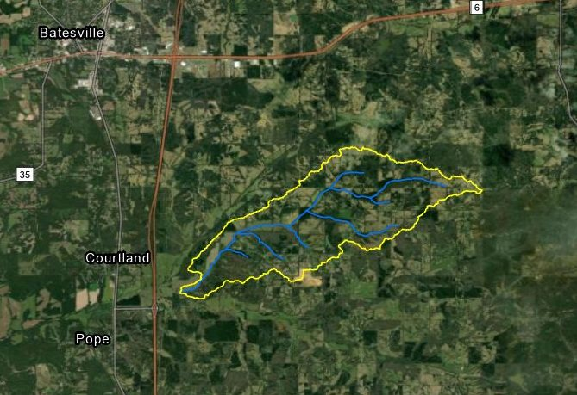









Incorporating nutrient flow into overland flow and groundwater models to better predict ecological response across large scales Todd E. Steissberg, PhD, PE
The flow of nutrients has a profound impact on how species utilize resources across watershed scales. Climate change and other disturbances are disrupting nutrient cycling, leading to imbalances and nutrient deficiencies or excesses that can have cascading effects on ecosystem health and functioning. Invasive species have the ability to take advantage of changes in nutrient dynamics, allowing them to outcompete other species. Currently, nutrient flow is not simulated across watershed scales. This hinders our ability to accurately predict the spatial distribution of species across landscapes in response to changing conditions, preventing identification of targeted ecosystem restoration strategies and effective management interventions, including implementation of measures to control the spread of invasive species.
Incorporating nutrient flow with existing watershed and river-floodplain models (GSSHA and HEC-RAS) via the ClearWater modeling framework and coupling with ERDC’s vegetation models:
Extend the ClearWater (Corps Library for Environmental Analysis and Restoration of Watersheds) modeling framework to link water quality simulations with the GSSHA and HEC-RAS-2D models for integrated watershed and floodplain nutrient and ecological modeling
Improve GSSHA’s temperature simulation capability using ClearWater
Develop watershed nutrient flow simulation capabilities in ClearWater, including in-stream, overland, and sub-surface flows
Link ClearWater with ERDC’s multi-species aquatic and terrestrial vegetation models
Improved understanding of how nutrient dynamics influence species distribution patterns and interactions with invasive species.
Enhanced ability to predict and develop targeted ecosystem restoration strategies based on nutrient availability and species responses.
Better insights into the role of nutrient cycling in ecosystem functioning, enabling informed management decisions to promote resilience.
FY23 IPR ANSRP Next Generation Ecological Modeling

Slide 2
Incorporating nutrient flow into overland flow and groundwater models to better predict ecological response across large scales
GSSHA
Variable Initialization
Overland & Stream Flow
Overland & Stream Transport
Overland & Stream Sediments
Water Temperature
Overland, Stream, Point Sources, Net Heat Flux, Sediment Heat Flux
Nutrients
Overland, Stream and Sub-surface: Kinetics, Cycling, Sorption/Desorption
ERDC Vegetation Models
Velocities, Shear Stresses, Sediment & Soil Erosion and Deposition, Flow Depths, Nutrient Concentrations, Water Temperature
Established EL-CHL-USGS Collaboration to link H&H models (GSSHA/HEC-RAS), ClearWater (temperature and nutrients), and PHREEQC (USGS) via the Basic Modeling Interface (BMI)
Developed integrated temperature simulation capability for streams
Developed framework to link temperature and nutrient models with H&H flow models
Nutrient flow capability in progress
Developed a graphical tool to visualize time series of model inputs and simulation results (temperature, nutrients, vegetation, etc.)
Statistics, time series methods to compute the running mean, min, and max for hourly, daily, weekly, monthly, annual, and decadal intervals; cumulative mean, min, and max
Support for Excel, CSV, and SQLite input and output
Linking 2D inputs and outputs with WMS for visualization
Basic Model Interface (BMI)
FY23 IPR ANSRP Next Generation Ecological Modeling
Notes:
The Basic Model Interface (BMI) is a library specification developed by the Community Surface Dynamics Modeling System (CSDMS) to enable easy integration of models and datasets into a modeling framework or application. It allows models to become reusable and plug-and-play components, streamlining the process of model integration and interoperability. BMI is a powerful tool for promoting model interoperability and reusability within the modeling community. By adhering to the BMI standard, models become easier to work with, integrate, and control, leading to enhanced collaboration and efficiency in ecological and environmental modeling efforts.
Key characteristics include:
Self-Description: By implementing BMI functions, a model becomes self-describing, providing essential information about its inputs, outputs, and available functionalities. This self-description enables other components or tools to interact with the model seamlessly.
Full Controllability: The BMI functions grant full control over the model's behavior to the modeling framework or application utilizing the model. This control allows the framework to initialize, run, update, and finalize the model as needed.
Simple Implementation: The BMI functions are designed to be straightforward to implement in any programming language. They use standard data types found in language libraries, making it easier for model developers to integrate the BMI into their existing code.
Noninvasiveness: One of the key design principles of BMI is noninvasiveness. It ensures that the model's BMI does not make calls to other components or tools, and it remains independent of any framework-specific data structures. This lack of dependencies allows the model to be used independently without being tightly coupled to any particular framework.
No Framework Dependencies: Since the BMI does not introduce any dependencies into the model, it preserves the model's ability to be used as a stand-alone application. Models with a BMI can be used in isolation or seamlessly integrated into modeling frameworks that support the BMI standard.
Language Support: While a BMI can be written in any programming language, CSDMS currently supports four languages: C, C++, Fortran, and Python. This language support ensures that models implemented in different languages can still be integrated into the same modeling framework or application using the BMI standard.

Slide 3
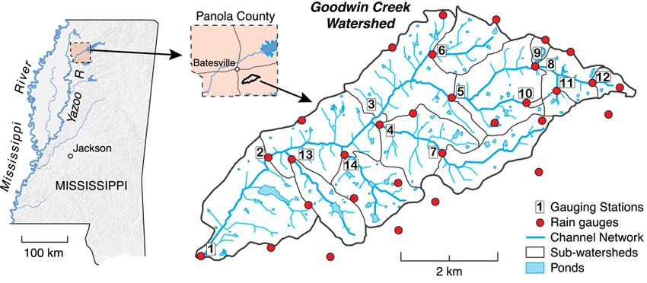
Incorporating nutrient flow into overland flow and groundwater models to better predict ecological response across large scales
Design plan to link H&H, temperature, and nutrient models – Q4 FY21 (completed)
Overland and sub-surface nutrient model design plan (TN) – Q4 FY22 (completed; in review)
ClearWater transport engine and framework completed – Q3 FY22
Conference presentations – ASABE and ICRW8 – Q3 FY23 (completed)
GSSHA water temperature capability – Q4 FY23 completed
GSSHA-ClearWater nutrient flow capability – Q4 FY23 (in progress)
Technical Report: Water Temperature Simulation Capability in GSSHA for Ecological Modeling – Q4 FY23 (in progress)
Technical Report: ClearWater Nutrient Simulation Capability for Ecological Modeling – Q1 FY24 (in progress)
Integrated Ecosystem Temperature and Nutrient Flow Models – Release Version – Q1 FY24 (in progress)
Complete modeling package for distribution
FY23 IPR ANSRP Next Generation Ecological Modeling

Slide 4
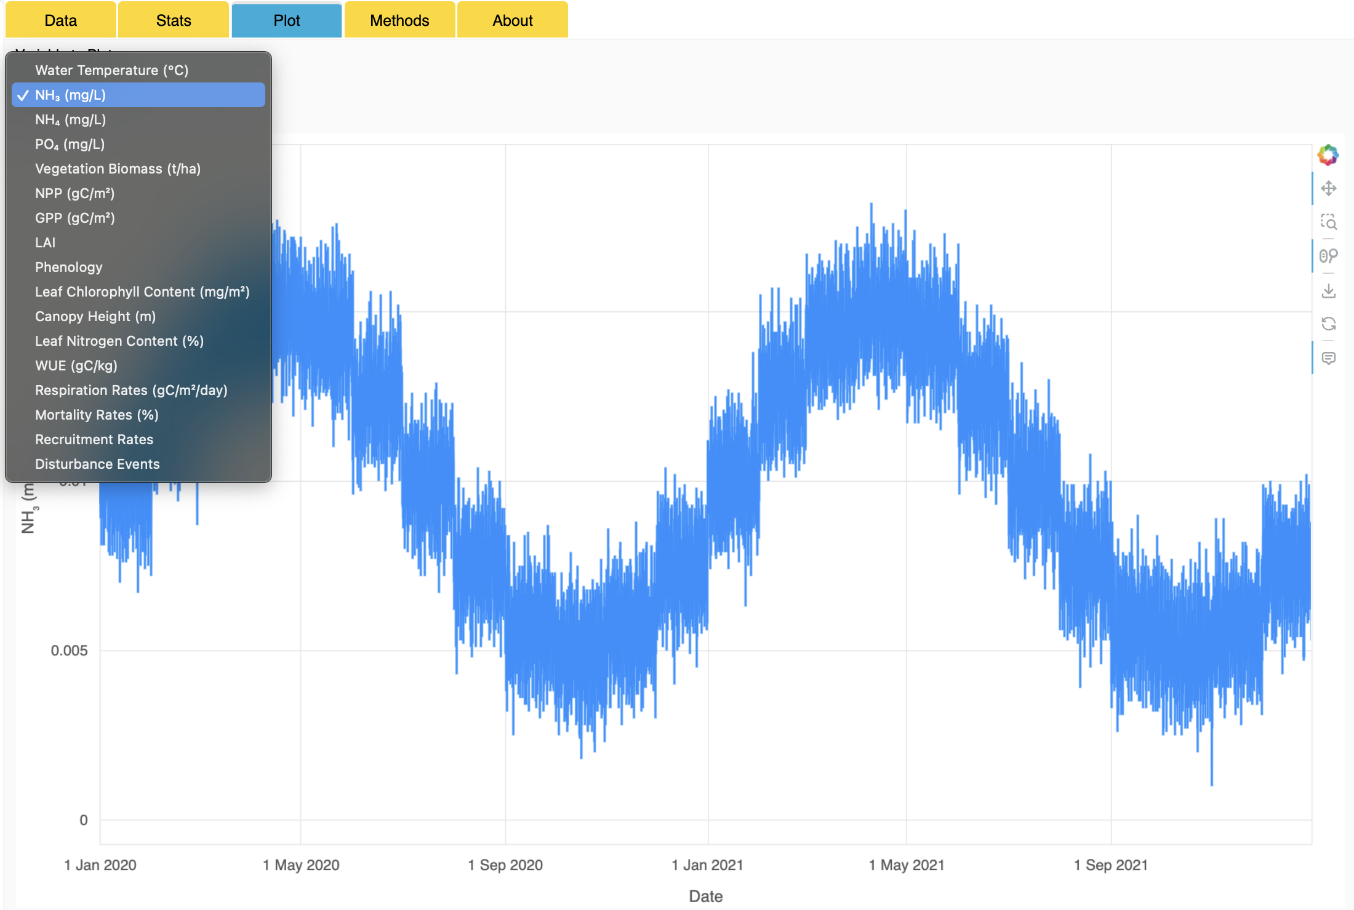
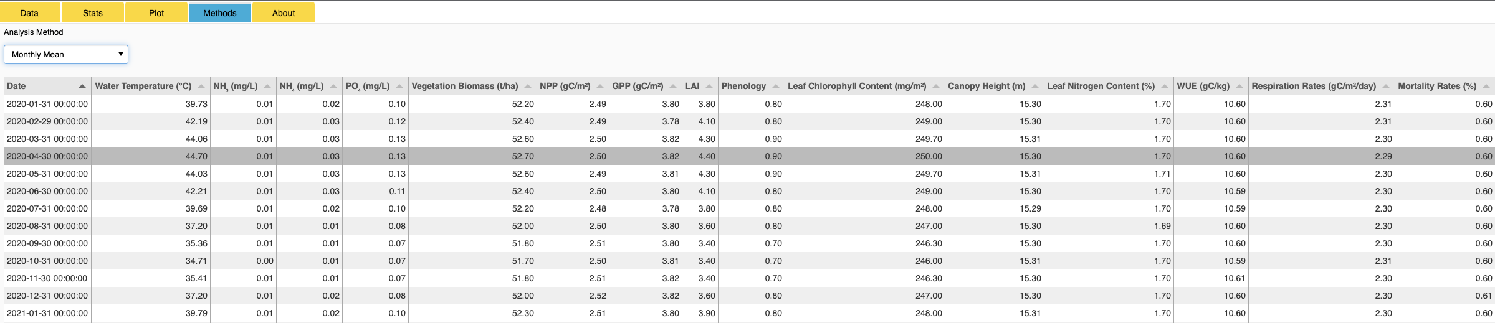
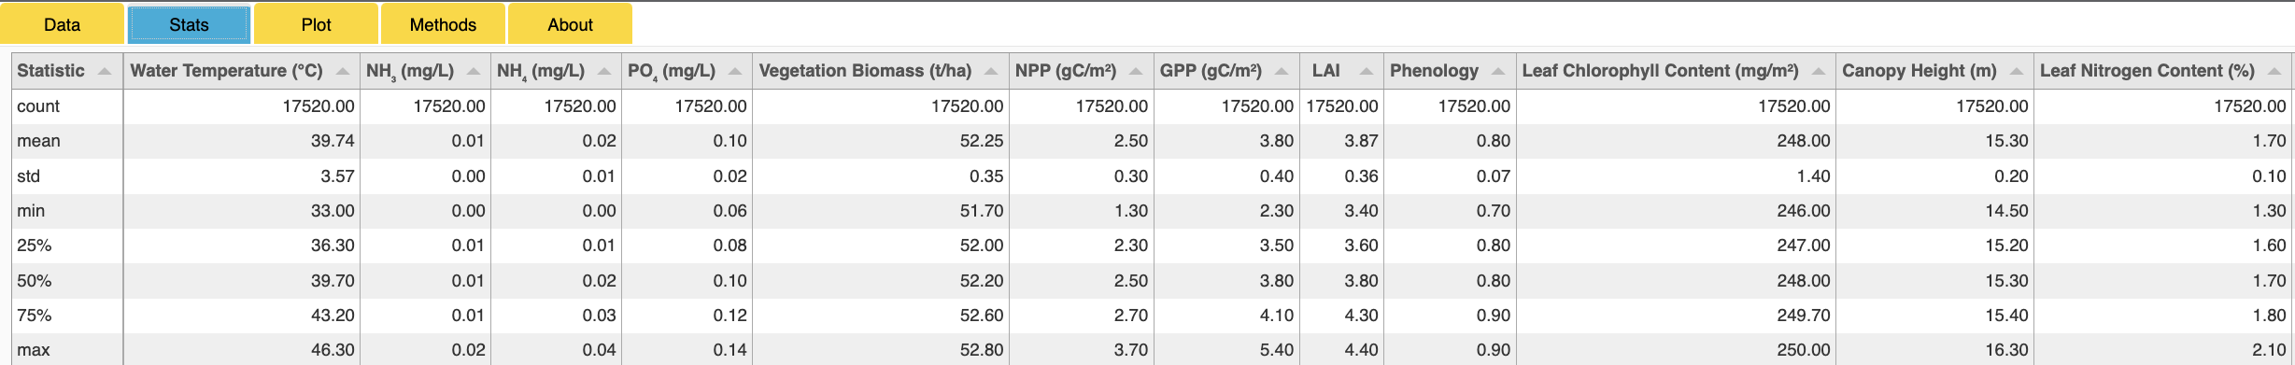
Incorporating nutrient flow into overland flow and groundwater models to better predict ecological response across large scales
Model linking using BMI enables a seamless exchange of data and information between different components of the integrated modeling system. This facilitates data-driven decision-making and enhances collaboration between scientists working on hydrology, water quality, vegetation, and other relevant disciplines.
The integrated models will enable a comprehensive representation of ecosystem dynamics. By considering the interactions between nutrients, water flow, and vegetation, the models can better simulate real-world processes and provide more accurate predictions of nutrient flows within the watershed.
This will enable assessment of the ecological responses to various environmental changes, such as land use modifications, climate change, or pollution control measures. This allows researchers and policymakers to make informed decisions about managing the ecosystem and mitigating potential adverse effects on water quality and vegetation. Example applications include: setting nutrient loading limits, designing buffer zones, and implementing best management practices to protect water resources and ecosystem health.
CHL, USGS, and LimnoTech
FY23 IPR ANSRP Next Generation Ecological Modeling

